Slide 1

Predicting Loan Defaulters through Predictive Modelling
TEAM 9
Asish Addepalli
Preethi Bachu
Priyanka Mulagandla
Travis Smith

Slide 2

Agenda
1
Business Understanding
2
Business Case
3
Data Understanding & Preparation
4
Data Modeling & Evaluation
5
Model Selection
6
Deployment & Estimated ROI
7
Critical Reflection
8
Q&A

Slide 3
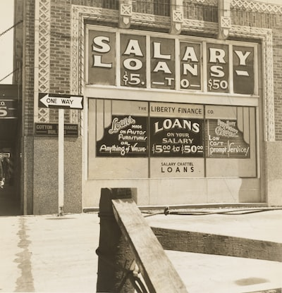
Business Understanding
Retail loan industry - Provides auto loans, personal loans,
mortgages, student loans
The Loan application process -
1
2
3
Submit Application
Lender Assessment
Loan Disbursement
#1 way lenders make money Charging interest
#1 way lenders
lose money
Loan defaults
5/4/23
Notes:
Retail loan industry:
Provides loans to individuals for personal needs e.g., Auto loans, personal loans, mortgages, student loans
Loan application process:
Submit application: Applicant provides personal and financial information e.g., name, address, income, etc.
Lender assessment: Lender reviews applicant’s information and determines eligibility/risks to then approve or deny application
Loan disbursement: Lender provides funds to the applicant (the borrower) upon acceptance of terms

Slide 4

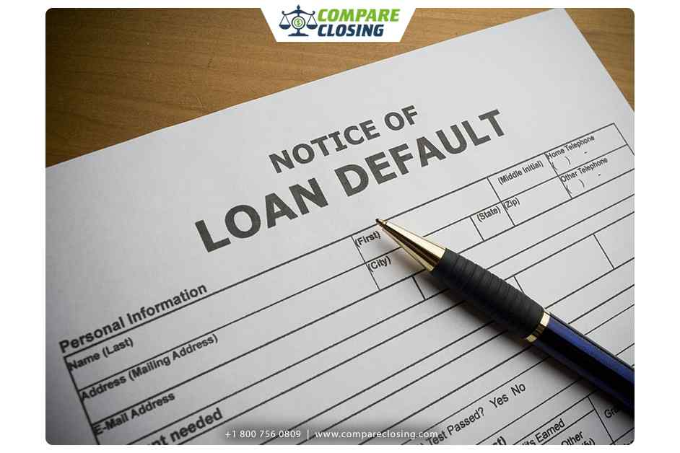
Business Case
Who
What
When
The retail loan issuer
Predict potential customers who will default to minimize default risk
Continuously monitor during the loan approval process with interventions before issuing the loan
Why
How
Increase profitability through reduced default rates
Improve internal controls based on data-driven insights
Maintain a healthy portfolio of investments
Utilize loan applicant data and our predictive model
Notes:
Who:
Client is a retail loan issuer
- Receives potential customer data from loan applications
- Maintains historical loan default data from existing customers
What:
Predict which potential customers will default in order to minimize risk of default.
When:
Continuous monitoring during the loan approval process with interventions (e.g., deny a bad applicant) before issuing the loan
Why:
Increase profitability through reduced default rates
Improve internal controls based on data-driven insights
Maintain a healthy portfolio of investments
How:
Utilizing loan applicant data and our predictive model

Slide 5



Data Understanding & Preparation
1
DATA SOURCING & TECHNOLOGIES USED
Source - Kaggle
Technology - Python, WEKA
UNDERSTANDING OUR DATA
Features - 13 (Categorical, Numeric)
Base rate - 12.3%
Instances - 252,000
3
DATA PREPARATION/ CLEANING
Removed - ID column
Modified - City column by removing unwanted numbers and characters
2

Slide 6
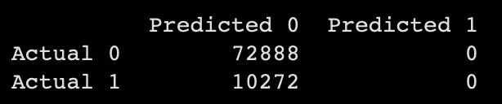
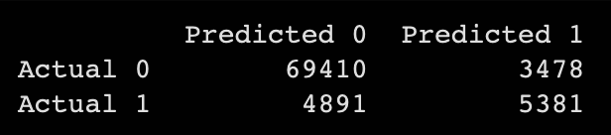
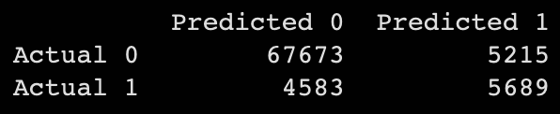
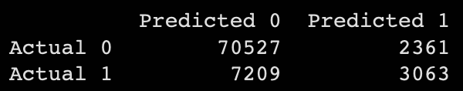
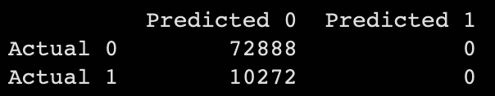
Data Modeling and Processing
Classifier | Target Variable | Accuracy | ROC | Confusion Matrix
Logistic Regression | Risk_Flag | 87.607% | 0.549
Random Forest | Risk_Flag | 89.930% | 0.938
Decision Tree | Risk_Flag | 88.217% | 0.852
KNN | Risk_Flag | 88.148% | 0.630
Naive Bayes | Risk_Flag | 87.647% | 0.548

Slide 7

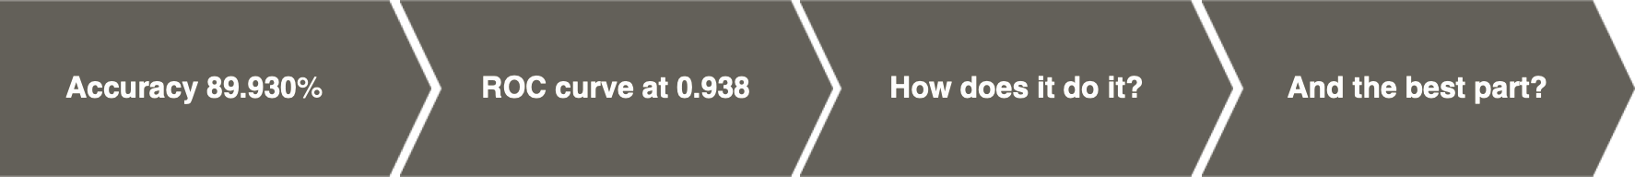
Random Forest is the WINNER!
Our Random Forest model reigns supreme with a whopping 89.930% accuracy!
By using an ensemble of decision trees, It reduces overfitting and improves generalization for more
reliable and robust predictions
It also boasts the highest area under the ROC curve
It can handle both categorical and continuous features, making it a versatile choice for a wide range of datasets

Slide 8

Deployment & Looking ahead
Security and updates
Data privacy and security ensured; model updated regularly
Compliance and risk management
Legal/regulatory requirements considered; risk management plan established
1
2
Estimating ROI
Cost savings
Reduced loan defaults
Increased profits
Improved risk assessment
1
2
Lower expenses
Reduced loan approval costs
Investment
Model development, deployment, and maintenance
3
4
Notes:
At the end of 2021, roughly 3 million people — close to 7% of all student loan borrowers — were in default. The total defaulted student loan balance was $86.08 billion at the end of 2021.
Estimating ROI
Cost savings from reduced loan defaults
Increase in profitable loans due to improved risk assessment
Reduction in operational expenses related to the loan approval process
Investment in model development, deployment, and maintenance
The deployment of the model has several implications for risk management and potential losses:
a. Informed Decision-Making: By quantifying the probability of commercial loan default, the model equips risk analysts with valuable insights to make informed decisions. They can use this information to determine suitable loan terms and conditions based on the risk associated with each borrower.
b. Risk Mitigation Measures: When the model predicts a high probability of default, lenders can take proactive risk mitigation measures. This could involve requesting additional collateral, adjusting loan terms, or increasing interest rates to compensate for the higher risk.
c. Portfolio Management: The model's predictions can guide portfolio management strategies. Lenders can allocate resources more effectively by focusing on low-risk borrowers or by closely monitoring high-risk borrowers to ensure timely intervention if default risks escalate.
d. Minimizing Losses: By accurately identifying potential defaulters, the model helps minimize losses associated with defaulting commercial loans. It allows lenders to avoid granting loans to high-risk borrowers who are more likely to default, reducing the potential financial impact of loan defaults.
e. Improved Performance: Deploying the predictive model enables lenders to improve the performance of their commercial loan portfolio. By incorporating an additional layer of risk assessment, lenders can optimize their loan approval process and ensure a healthier loan portfolio with a lower overall risk of default

Slide 9









Reflection
Deployment considerations
Ethical considerations
Risks and Mitigation
Integration
Training
Monitoring
Fairness
Privacy
Transparency
Overfitting
Incorrect Predictions
Legal Compliance
Notes:
Integration: Seamlessly integrate with existing systems.
Training and Change: Provide employee training and manage change.
Monitoring and Updates: Continuously monitor and update the model.
fairness and Bias: Prevent discrimination and ensure fairness.
Privacy Protection: Safeguard customer sensitive data.
Transparency: Communicate data-driven decision-making.
Overfitting: Use cross-validation and regularization.
Incorrect predictions: Update and monitor model performance.
Legal Compliance: Adhere to Fair Lending regulations.

Slide 10




Our Learning Curve
1
Data prep crucial: small discrepancies, big problems
2
Powerful narratives: Conveying insights through data
3
Harnessing team synergy: Embrace diverse expertise
4
Project Clarity: Define Goals and Objectives

Slide 11

Thank you!
Questions?

